Slide 1
CSIT 6910 Independent Project
Pervasive Positioning Standard
Yuan, Fangxu

Slide 2






Introduction
Imagine a Newcomer to Hong Kong
Customized Map Apps
Finding indoor location:
e.g.
Core Location
Accuracy
Coverage
Solution: Connect customized applications together so we need standards!

Slide 3




Introduction
Pervasive Positioning Standard
To enable seamless positioning services for different end users in different venues
Lookup server
My job is validating the map data
1. Map data, (site signal data)
2. Request service
Application
3. Location services
Site owner

Slide 4
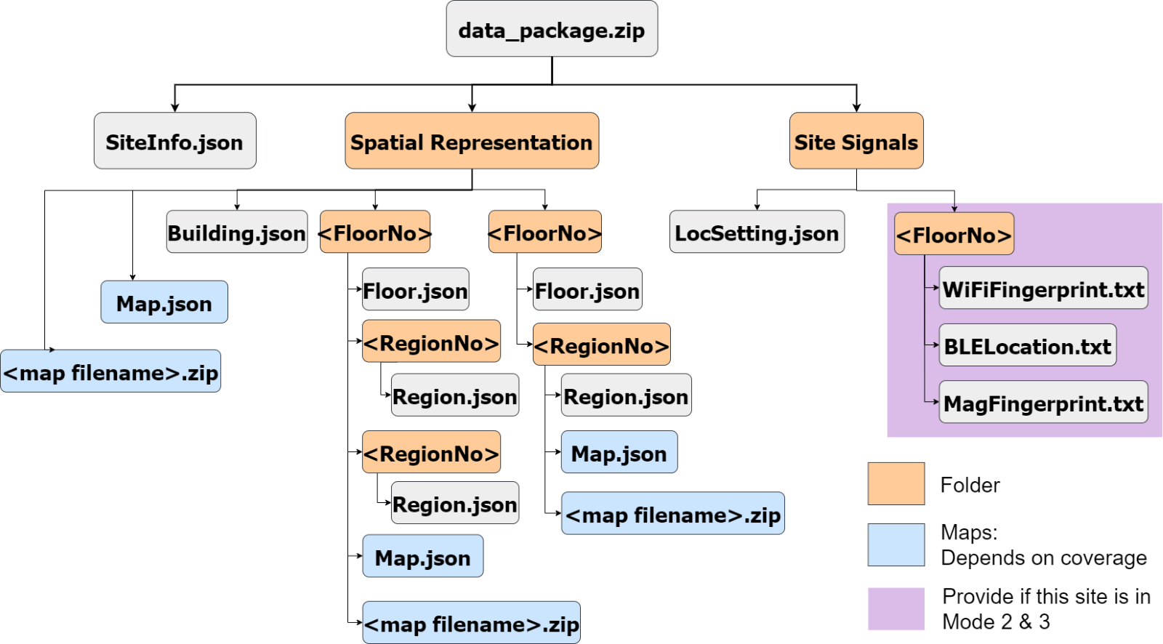
Data Package Structure
Indoor

Slide 5
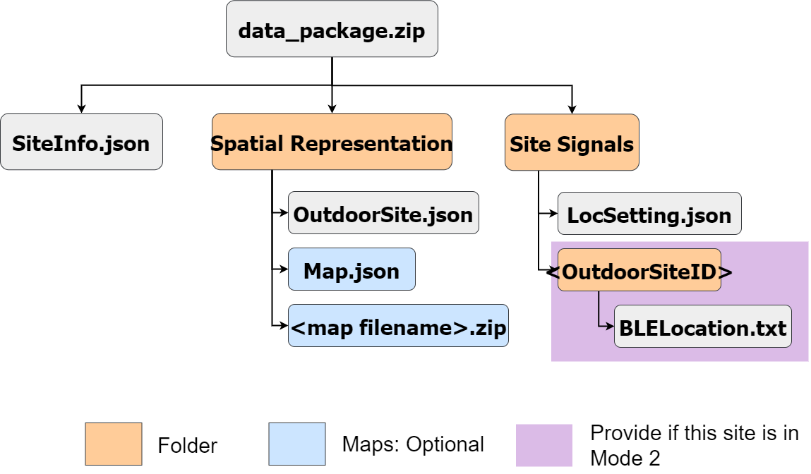
Data Package Structure
Outdoor

Slide 6
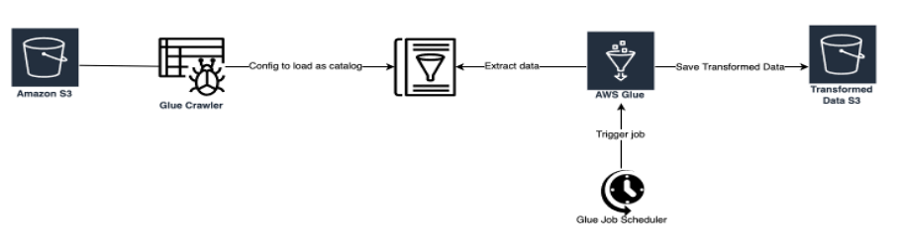
Method #1
Using AWS tool: Glue

Slide 7
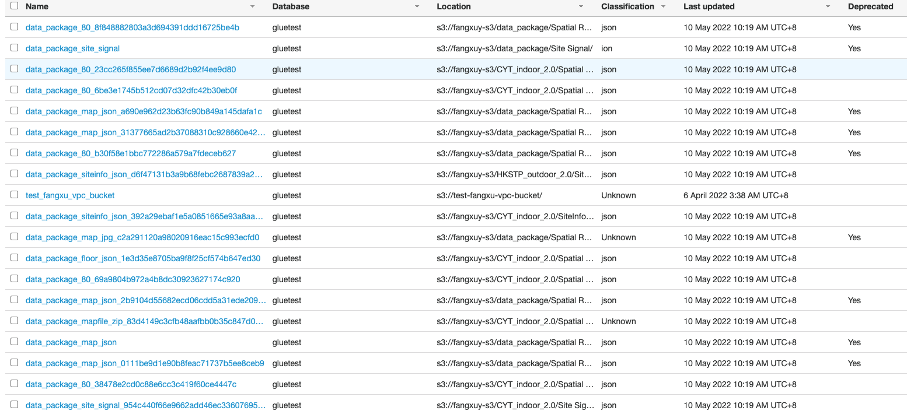
Method #1

Slide 8
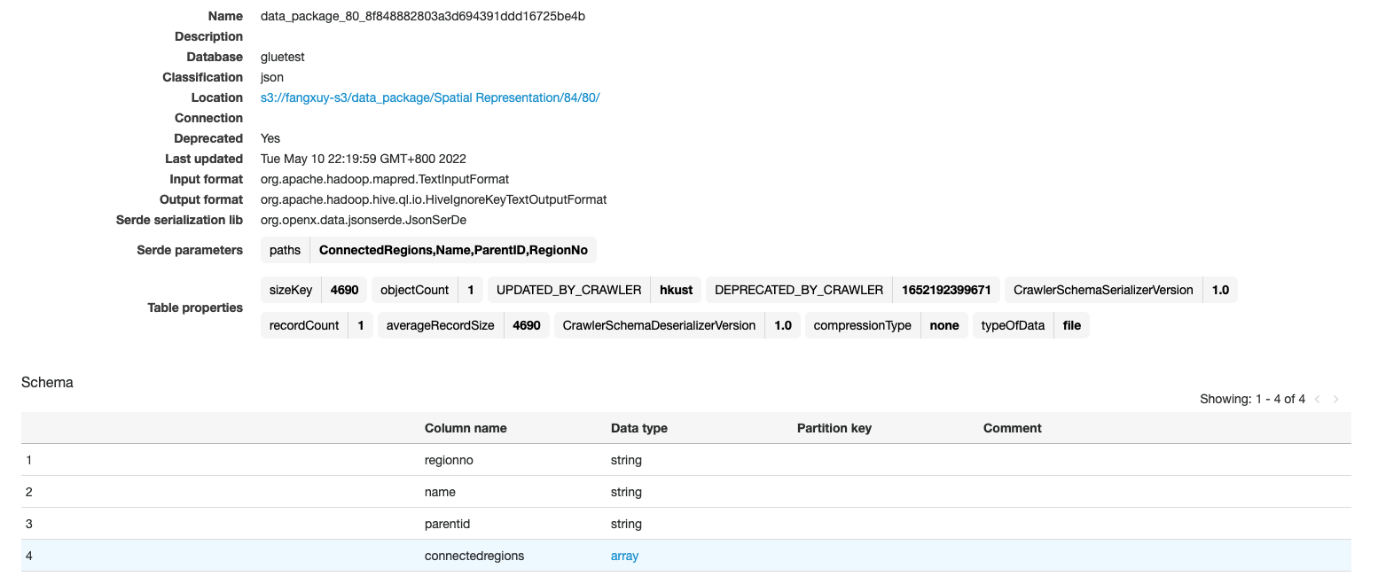
Method #1
Notes:
这里一个方法是使用AWS中一个叫做Glue的工具，当有新数据放入到s3中时，他就会被自动触发，进行数据格式的检查，如果数据格式是不合法的，他就会处理这些错误格式的数据

Slide 9
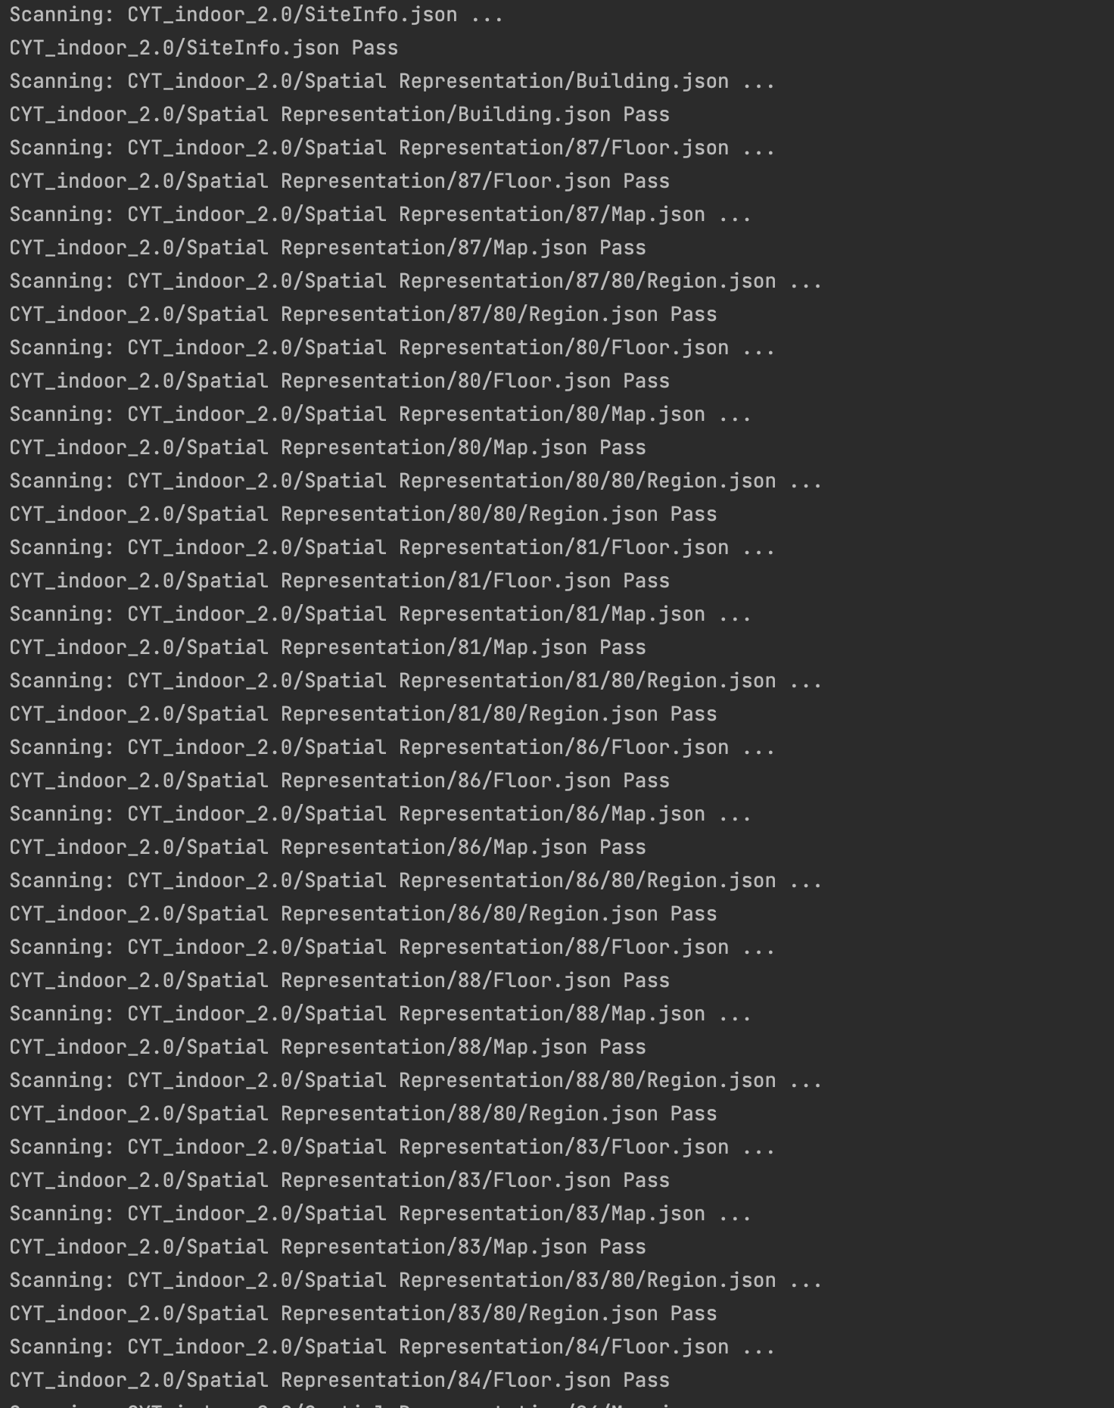
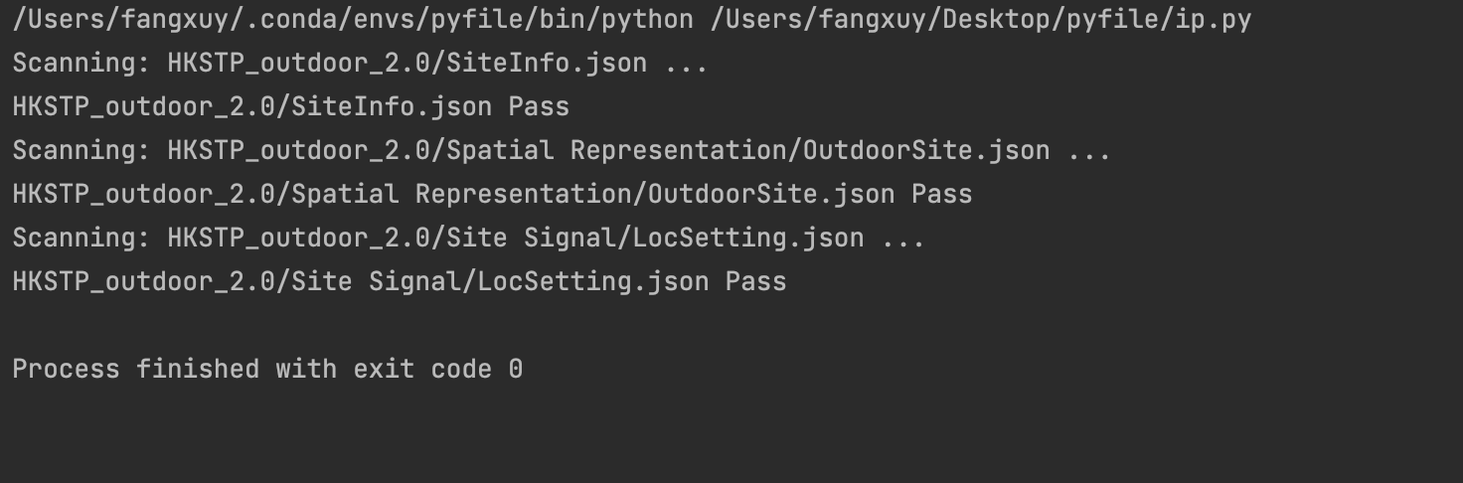
Method #2
Using Python Script:
Notes:
当我们收到室内的数据时，这是它的一个框架图

